Slide 1

Bike Sharing Analysis
Amanda Rorabaugh
Nicholas Aryel Ferreira

Slide 2
Agenda
Problem
Dataset
Exploratory Data Analysis
Variable Selection
Data Preparation
Results
Conclusions

Slide 3


Problem
The main purpose of this project is to evaluate the use of machine learning methods to predict the number of bike sharing rides based on historical data from Capital Bikeshare, a bike-sharing company.
The company
Machine Learning methods evaluated
Multiple linear regression
Elastic Net
Ridge regression
Poisson regression
LASSO
Decision Trees
Random Forest
Ada Boost
Bagging
Neural Networks
Mean Squared Training Error
Mean Squared Testing Error
Efficiency
R²
Parameters for evaluation
Opened in September 2010
Based on Washington DC
658 bike stations
+ 5,400 bicycles

Slide 4
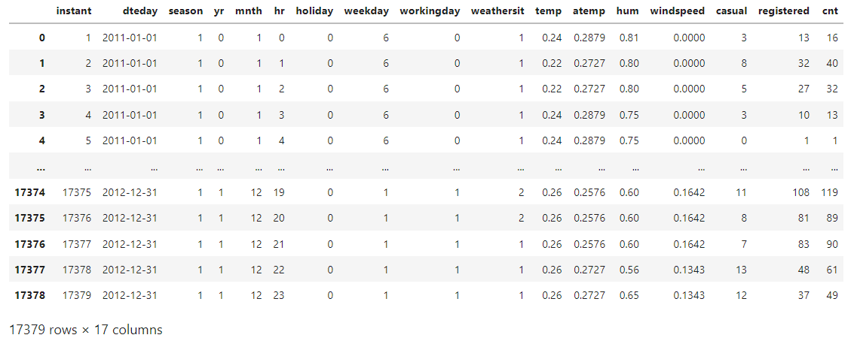
Dataset
The dataset was obtained through the UC Irvine Machine Learning Repository and contains 17,379 datapoints with 16 attributes aggregated by hour from 01/01/2011 to 12/31/2012. The repository also provides another version of the dataset aggregated by day.
Screenshot from the Dataset
Variables
instant: record index (not utilized) dteday : date (not utilized) season : season (1:winter, 2:spring, 3:summer, 4:fall) yr : year (0: 2011, 1:2012) mnth : month ( 1 to 12) hr : hour (0 to 23) holiday : weather day is holiday or not weekday : day of the week workingday : if day is neither weekend nor holiday is 1, otherwise is 0. weathersit : categorical variable for weather (1 to 4)
temp : Normalized temperature in Celsius
atemp: Normalized feeling temperature in Celsius hum: Normalized humidity. The values are divided to 100 (max) windspeed: Normalized wind speed. The values are divided to 67 (max) casual: count of casual users registered: count of registered users cnt: count of total rental bikes including both casual and registered
*The project will focus on the total rides (‘cnt’) as the response but will also present a comparison for casual and registered rides.
https://archive.ics.uci.edu/ml/datasets/bike+sharing+dataset#

Slide 5
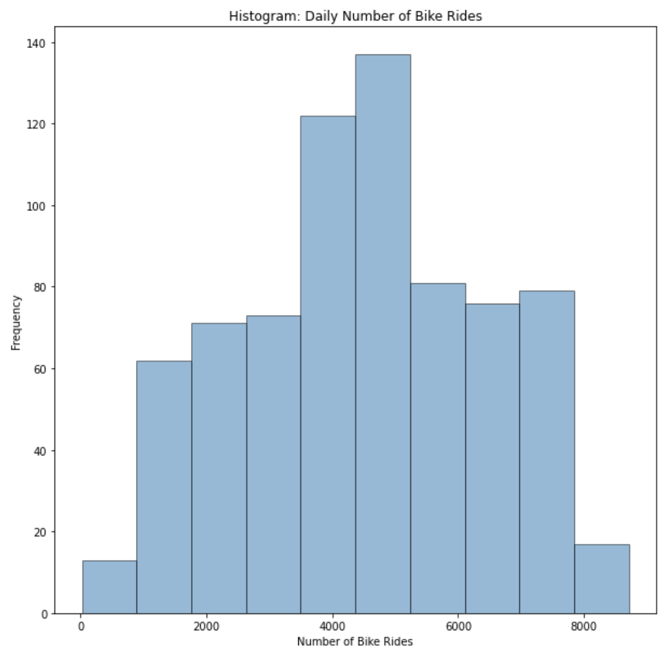
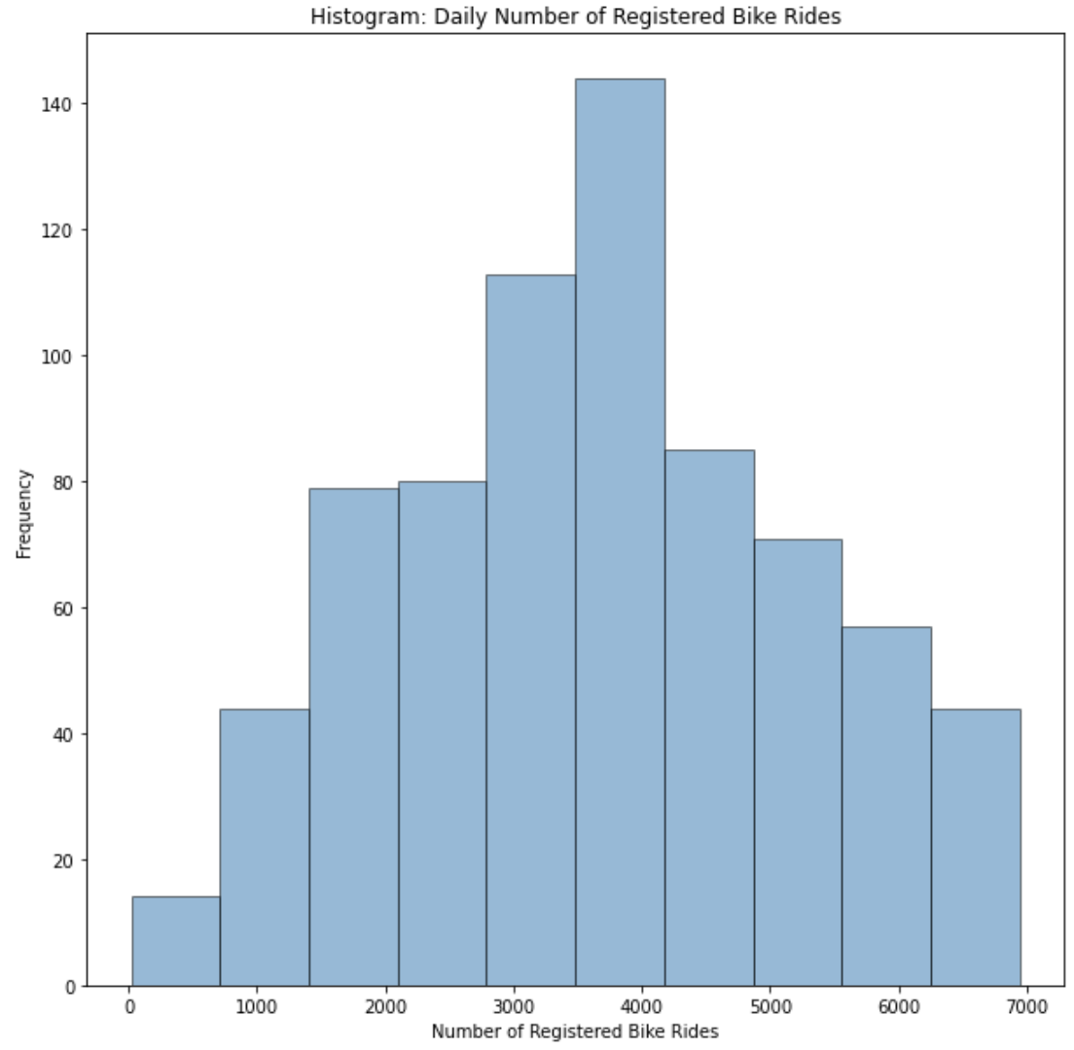
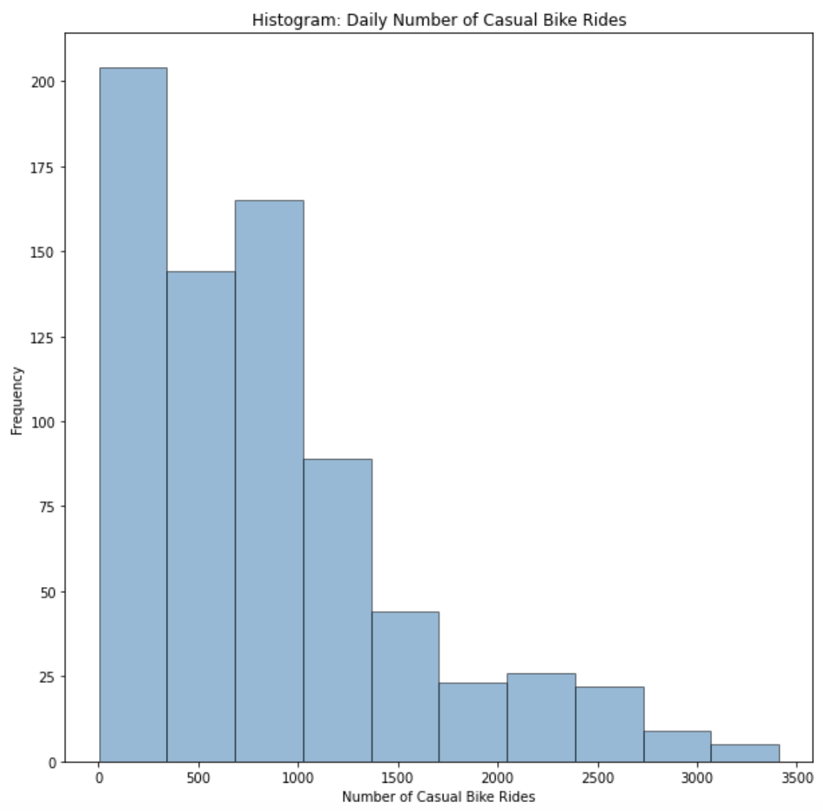
Exploratory Data Analysis
An initial analysis of the distribution of daily bike rides reveals that both the total number of bike rides and registered bike rides present a symmetric distribution that resembles a normal curve, while the distribution of the number of casual rides is heavily skewed to the right because of the irregularity in the frequency of casual rides over time.

Slide 6
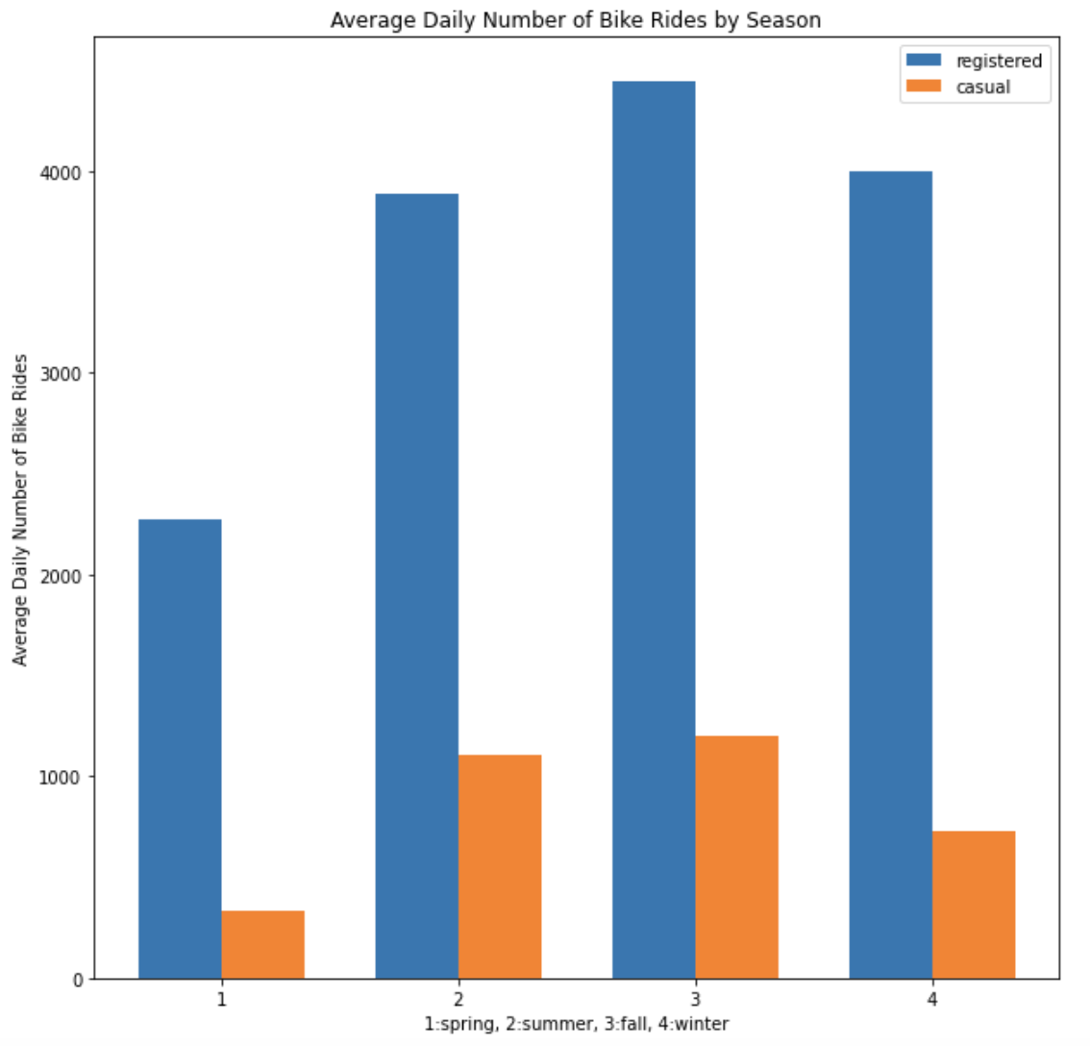
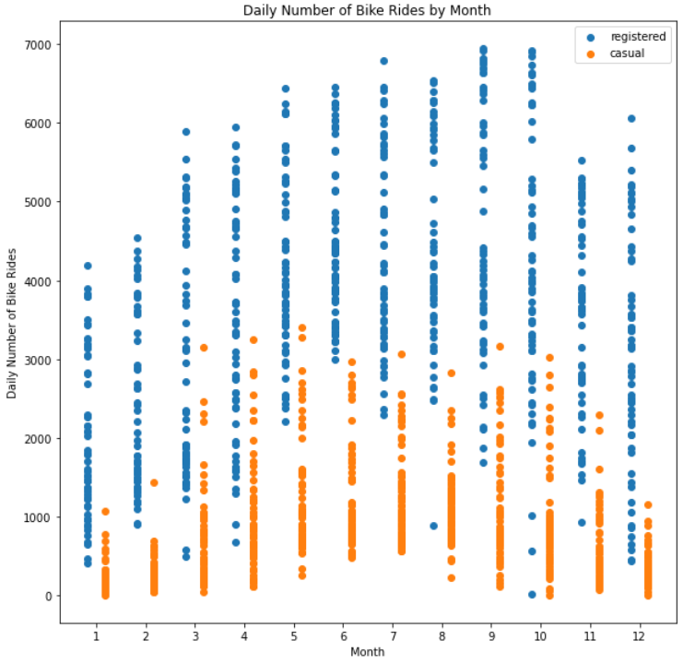
Exploratory Data Analysis
The analysis of the number of bike rides over time reveals that the demand is usually higher in the middle of the year, corresponding to the seasons of summer and fall, for both registered and casual riders.

Slide 7
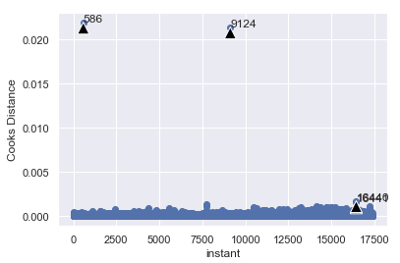
Exploratory Data Analysis
Cook’s distance was utilized to find the outliers in the hourly dataset.
Cook’s Distance
There were 4 outliers identified using Cook’s distance for the dataset aggregated by hour. This is a low number considering a dataset of 17,380 observations and thus do not have a significant effect on the analysis.
In the dataset aggregated by day, there was an outlier associated to the day when Washington DC was in a state of emergency due to Hurricane Sandy. On this day, there were only 22 bike rides.

Slide 8
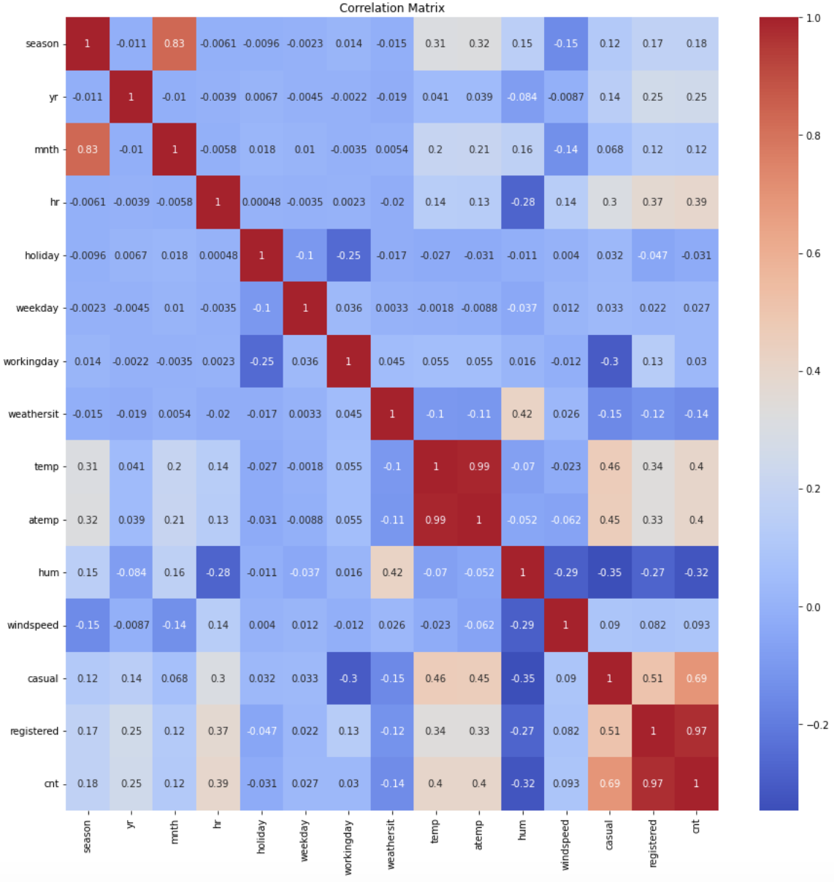
Exploratory Data Analysis
The correlation matrix reveals a strong correlation between the variables month (mnth) and season, as well as atemp and temp.
The data also suggests a moderate correlation between the temperature (temp, atemp) and the number of rides (casual, registered, cnt).

Slide 9
Variable Selection
Five methods of variable selection were utilized to determine which variables significantly contribute to the prediction of the total number of bike rides in each hour.
Method | Features Eliminated
Backward selection based on p-value of variables in an ordinary least squares model | mnth, workingday
Recursive feature elimination (backward) | mnth, weekday
Sequential feature selection (forward) | mnth, windspeed
Sequential feature selection (backward) | mnth, temp
LASSO for variable selection | mnth
Result: The variable "mnth" (month) is the only variable eliminated in all methods, therefore, it will not be used in the models.

Slide 10
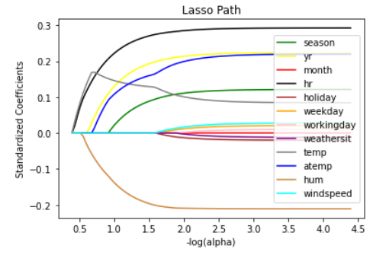
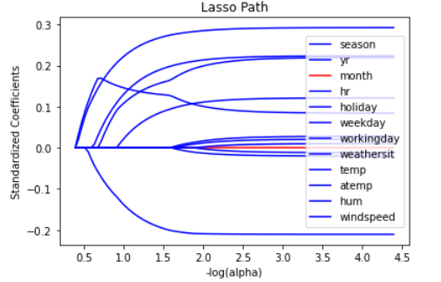
Variable Selection - LASSO
As an example of the variable selection methods, the LASSO path showed that the variable month should be the first to be eliminated from all other variables.
The LASSO path shows the most significant variables according to the regularization parameter. Notice that for higher values of the parameter, the variable “month” is the last to be selected (in red).

Slide 11
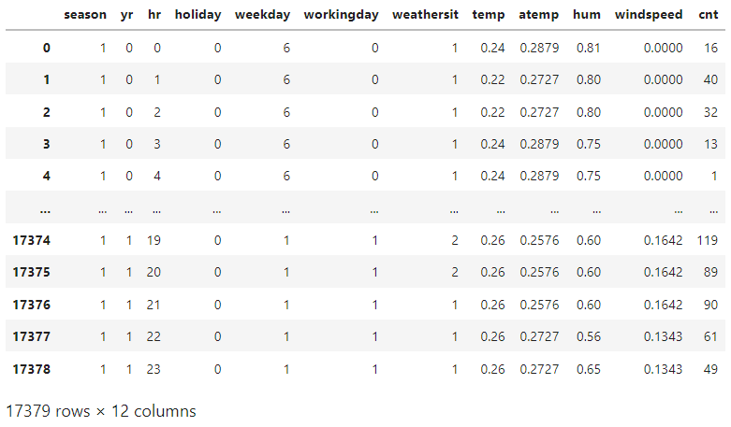
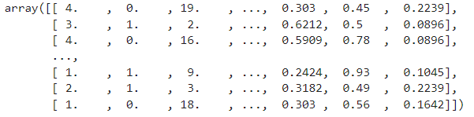
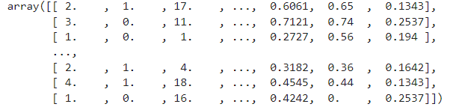
Data Preparation
Having selected the explanatory variables, the dataset was transformed into a 2D array and randomly divided into a training set (80%) and testing set (20%) for the explanatory variables (X) and response (Y).
Screenshot from the dataset
X and Y training sets (80%)
X and Y testing sets (20%)

Slide 12
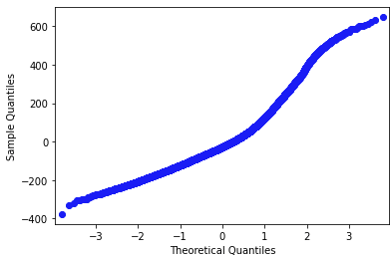
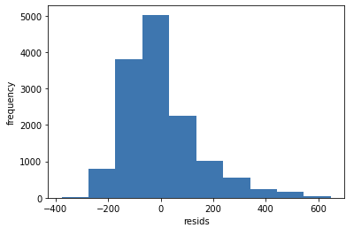
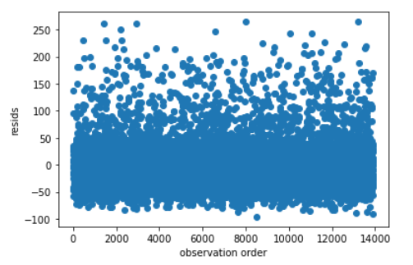
Results – Multiple Linear Regression
The multiple linear regression model fits a linear model through the method of least squares to minimize the residual sum of squares.
Normal Probability Plot
Histogram of Residuals
Residuals vs Observations
Results obtained
Mean squared training error | 19978.397
Mean squared testing error | 20709.979
R-Squared | 0.708
Training time | 0.0087s
The charts above were developed to assess the assumptions for the regression model.
The normal probability plot and the histogram of residuals show that the residuals from the model are approximately normal.
The residuals vs observations chart shows that the variance is constant across the observations.
The linear regression model presented a medium performance on R-Squared and a shorter training time compared to other models. Its testing error, however, is relatively high compared to the ensemble methods that will be shown in the next slides.

Slide 13
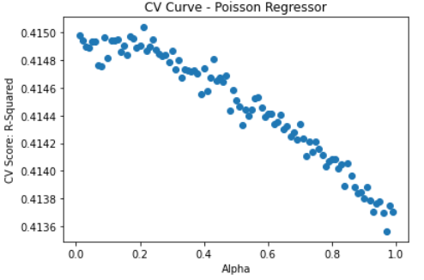
Results – Poisson Regression
Poisson Regression is a generalized linear model which assumes that the response variable has a Poisson distribution.
5-Fold Cross-Validation
Results obtained
Best parameter alpha from cross-validation | 0.21
Mean squared training error | 20373.849
Mean squared testing error | 20752.959
R-Squared | 0.386
Training time | 0.0764s
Poisson Regression performed worse than most models in terms of testing error and R-Squared. Its training time is relatively short.
One possible explanation is the fact that the number of bike rides per hour does not properly follow a Poisson distribution.
A cross-validation was performed to assess the best parameter alpha according to the CV score from the GridSearchCV function.
The chart shows that the score peaks when alpha is between 0.2 and 0.3.

Slide 14
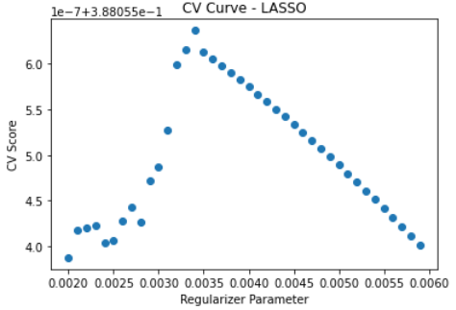
Results – LASSO
In this model, some variables have their coefficient set to zero while others are preserved through the Least Absolute Selection and Shrinkage Operator (LASSO). It works well for when the true model is sparse.
5-Fold Cross-Validation
Results obtained
Best regularizer parameter from cross-validation | 0.0034
Mean squared training error | 19963.211
Mean squared testing error | 20693.294
R-Squared | 0.387
Training time | 0.0235s
The LASSO model presented a relatively low R-Squared and high testing error compared to other models. Its training time, like the other regression models, is relatively short.
A cross-validation was performed to assess the best regularizer parameter according to the CV score from the GridSearchCV function.
The chart shows that the score peaks when the regularizer parameter is between 0.003 and 0.004.

Slide 15
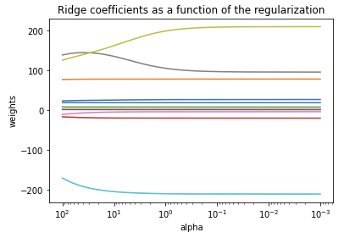
Results - Ridge Regression
Ridge Regression is a type of regression that uses regularization to reduce variance, shrinking the regression coefficients towards 0, which also adds some bias to the model.
Results obtained
Best alpha from cross-validation | 1.743
Mean squared training error | 19963.715
Mean squared testing error | 20691.323
R-Squared | 0.387
Training time | 0.0123s
Like LASSO, Ridge Regression presented a relatively low R-Squared and high testing error compared to other models. Its training time, like the other regression models, is relatively short.
The chart above shows the Ridge Coefficients of the model as a function of the regularization parameter alpha.

Slide 16
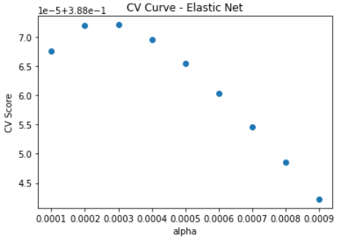
Results – Elastic Net
Elastic Net combines the variable selection benefits of LASSO with the prediction benefits of Ridge Regression.
5-Fold Cross-Validation
Results obtained
Best alpha from cross-validation | 0.0003
Mean squared training error | 19963.876
Mean squared testing error | 20691.132
R-Squared | 0.387
Training time | 0.0098s
Like LASSO and Ridge Regression, Elastic Net presented a relatively low R-Squared and high testing error compared to other models. Its training time, like the other regression models, is relatively short.
A cross-validation was performed to assess the best alpha parameter according to the CV score from the GridSearchCV function.
The chart shows that the score peaks when the alpha is between 0.0002 and 0.0003.

Slide 17
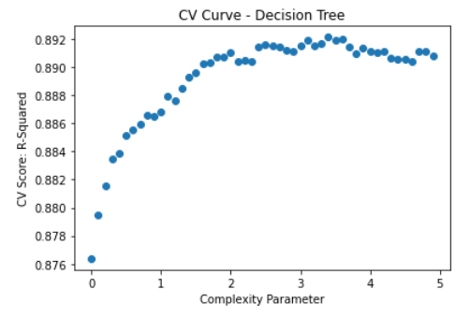
Results - Decision Tree
The Regression Decision Tree was utilized, which is an intuitive model that predicts a response based upon the partition of the feature space into several regions, which can be thought as a special case of additive model.
5-Fold Cross-Validation
Results obtained
Best complexity parameter from cross-validation | 3.4
Mean squared training error | 1826.529
Mean squared testing error | 3262.878
R-Squared | 0.903
Training time | 0.5365s
The Decision Tree model performed better than the previous models in terms of R-Squared and testing error.
Although the training time is higher than the previous models, it is still much shorter than the training time for the ensemble methods and neural networks which will be seen in the next slides.
A cross-validation was performed to assess the best complexity parameter according to the CV score from the GridSearchCV function.
The chart shows that the score peaks when the complexity parameter is between 3 and 4.

Slide 18
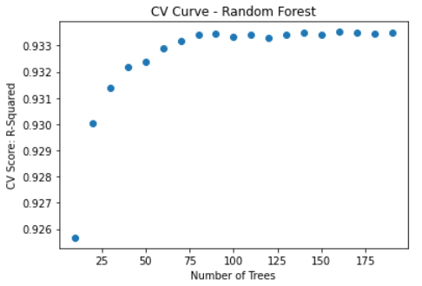
Results - Random Forest
The Random Forest for regression was utilized, which is an ensemble of regression decision trees that predicts based on the average results from different trees.
5-Fold Cross-Validation
Results obtained
Best number of trees from cross-validation | 160
Mean squared training error | 288.226
Mean squared testing error | 1774.569
R-Squared | 0.947
Training time | 5.0749s
The Random Forest was the best model in terms of R-Squared and testing error, along with Bagging which will be seen in the next slides.
Its training time, however, is relatively high compared to the other models.
A cross-validation was performed to assess the best number of trees according to the CV score from the GridSearchCV function.
The chart shows that the score peaks when the number of trees is between 100 and 200.

Slide 19
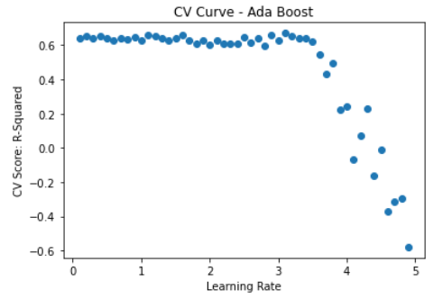
Results - AdaBoost
Adaboost is an ensemble algorithm that uses several weak learners to predict. Each weak learner performs slightly better than random guessing.
5-Fold Cross-Validation
Results obtained
Best learning rate from cross-validation | 3.1
Mean squared training error | 10503.712
Mean squared testing error | 10449.236
R-Squared | 0.691
Training time | 1.3349s
The AdaBoost algorithm obtained a medium performance in terms of R-Squared, testing error and training time.
The predictability was better than other models such as Ridge Regression and LASSO, but lower compared to the other ensemble methods, decision tree, and neural networks.
A cross-validation was performed to assess the best learning rate according to the CV score from the GridSearchCV function. The number of estimators (trees) was set as 160 from the CV results with Random Forest.
The chart shows that the score peaks when the learning rate is between 3 and 3.5.

Slide 20
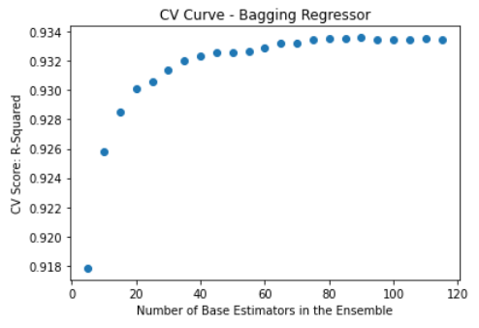
Results - Bagging
Bootstrap aggregating (Bagging) is an ensemble method that generates many bootstrapping samples reusing the data, and for each sample it builds a distinct tree, providing a final prediction as the average across the predictions of all trees.
5-Fold Cross-Validation
Results obtained
Best number of estimators from cross-validation | 90
Mean squared training error | 294.090
Mean squared testing error | 1797.511
R-Squared | 0.947
Training time | 2.9447s
The bagging algorithm had the best performance in terms of R-Squared along with the Random Forest model.
It also provided a low testing error, but a high training time compared to other methods.
A cross-validation was performed to assess the best number of base estimators according to the CV score from the GridSearchCV function.
The chart shows that the score peaks when the number of base estimators is between 80 and 120.

Slide 21
Results - Neural Networks
A multi-layer perceptron regressor (MLP Regressor) was utilized, which learns a non-linear function for regression using layers of perceptrons (neurons), where each layer receives input values from the previous layer and transforms them into output values.
Results obtained
Since there are many parameters to assess in Cross-Validation for Neural Networks, a different approach was taken.
Cross-validation was performed across different types of parameters in a total of 48 combinations:
neural_parameters = {
'hidden_layer_sizes': [(50,50,50), (50,100,50), (100,)],
'activation': ['tanh', 'relu'],
'solver': ['sgd', 'adam'],
'alpha': [0.0001, 0.05],
'learning_rate': ['constant','adaptive'],
}
Best estimators from cross-validation | Activation: relu alpha: 0.0001 Hidden layer sizes: 50, 50, 50 Learning rate: constant Solver: adam
Mean squared training error | 2456.847
Mean squared testing error | 2443.998
R-Squared | 0.928
Training time | 11.5224s
Neural Networks obtained a high performance in terms of R-Squared and testing error, although its training time is the highest compared to all other models.

Slide 22
Results - Summary
The results of all models predicting the total number of bike rides (“cnt”) is summarized in the table below.
Model | Optimal parameter(s) | Mean Squared Training Error | Mean Squared Testing Error | R-Squared | Training Time (in seconds)
Multiple Linear Regression | N/A | 19978.397 | 20709.979 | 0.708 | 0.0087
Poisson Regression | alpha: 0.21 | 20373.849 | 20752.959 | 0.386 | 0.0764
LASSO | alpha: 0.0034 | 19963.211 | 20693.294 | 0.387 | 0.0235
Ridge Regression | alpha: 1.743 | 19963.715 | 20691.323 | 0.387 | 0.0123
Elastic Net | alpha: 0.0003 | 19963.876 | 20691.132 | 0.387 | 0.0098
Decision Tree | Complexity penalty: 3.4 | 1826.529 | 3262.878 | 0.903 | 0.5365
Random Forest | Number of trees: 160 | 288.226 | 1774.569 | 0.947 | 5.0749
AdaBoost Regressor | Learning rate: 3.1 | 10503.712 | 10449.236 | 0.691 | 1.3349
Bagging Regressor | Number of estimators: 90 | 294.090 | 1797.511 | 0.947 | 2.9447
Neural Networks | Activation: relu alpha: 0.0001 Hidden layer sizes: 50, 50, 50 Learning rate: constant Solver: adam | 2456.847 | 2443.998 | 0.928 | 11.5224

Slide 23
Results - Summary
The results of all models predicting the registered bike rides (“registered”) is summarized in the table below.
Model | Optimal parameter(s) | Mean Squared Training Error | Mean Squared Testing Error | R-Squared | Training Time (in seconds)
Multiple Linear Regression | N/A | 15079.134 | 16037.700 | 0.673 | 0.008
Poisson Regression | alpha: 0.02 | 15226.296 | 16012.273 | 0.334 | 0.073
LASSO | alpha: 0.0038 | 15034.419 | 15983.726 | 0.335 | 0.026
Ridge Regression | alpha: 1.603 | 15034.769 | 15982.235 | 0.335 | 0.034
Elastic Net | alpha: 0.002 | 15038.628 | 15982.743 | 0.335 | 0.0131
Decision Tree | Complexity penalty: 1.5 | 952.859 | 2118.556 | 0.912 | 0.524
Random Forest | Number of trees: 190 | 192.544 | 1289.923 | 0.946 | 6.181
AdaBoost Regressor | Learning rate: 2.7 | 7595.331 | 7848.770 | 0.673 | 0.363
Bagging Regressor | Number of estimators: 95 | 196.866 | 1298.313 | 0.946 | 3.144
Neural Networks | Activation: relu alpha: 0.05 Hidden layer sizes: (50,100,50) Learning rate: adaptative Solver: adam | 1579.683 | 1572.073 | 0.935 | 16.734

Slide 24
Results - Summary
The results of all models predicting the casual bike rides (“casual”) is summarized in the table below.
Model | Optimal parameter(s) | Mean Squared Training Error | Mean Squared Testing Error | R-Squared | Training Time (in seconds)
Multiple Linear Regression | N/A | 1345.674 | 1273.946 | 0.641 | 0.011
Poisson Regression | alpha: 0.02 | 1329.809 | 1208.525 | 0.480 | 0.091
LASSO | alpha: 0.0011 | 1337.893 | 1263.393 | 0.456 | 0.027
Ridge Regression | alpha: 4.325 | 1337.935 | 1263.274 | 0.456 | 0.005
Elastic Net | alpha: 0.0007 | 1337.947 | 1263.270 | 0.456 | 0.008
Decision Tree | Complexity penalty: 0.600 | 246.451 | 324.111 | 0.860 | 0.402
Random Forest | Number of trees: 190 | 33.515 | 211.214 | 0.909 | 5.755
AdaBoost Regressor | Learning rate: 0.1 | 686.056 | 647.466 | 0.721 | 2.369
Bagging Regressor | Number of estimators: 95 | 34.139 | 212.183 | 0.909 | 2.983
Neural Networks | Activation: tanh alpha: 0.05 Hidden layer sizes: 50, 100, 50 Learning rate: constant Solver: adam | 184.707 | 225.069 | 0.903 | 23.136

Slide 25
Conclusions
Based on the assessment of the results from each method utilized in the prediction of bike rides, the following conclusions were drawn.
1
The Random Forest and Bagging models proved to be the most effective models to predict the number of bike rides, as shown by their R-Squared (0.95), followed by Neural Networks (0.93) and Decision Tree (0.90). They also provided the lowest testing errors.
Random Forest and Bagging models have in common that they utilize an ensemble of predictors (trees) and take as the final prediction the average of predictions from each predictor, which reduces variance if compared to a single tree model.
This variance reduction proved to be very important in developing an effective model for this problem of predicting bike rides.
2
3

Slide 26
Conclusions
Based on the assessment of the results from each method utilized in the prediction of bike rides, the following conclusions were drawn.
4
Other models such as Multiple Linear Regression and LASSO had a lower performance comparetively. However, they were more efficient in terms of training time.
One Interesting fact is that while Random Forest and Bagging presented a significant difference between training and testing errors, the Neural Networks model presented a testing error that was slightly lower than the training error, while providing good prediction results.
This may suggest that neural networks was more effective in avoiding overfitting of the training data, even though neural networks presented the highest training time.
5

Slide 27
Conclusions
Based on the assessment of the results from each method utilized in the prediction of bike rides, the following conclusions were drawn.
6
For the models with highest predictability, which obtained a R-Squared greater than 0.9, the performance was relatively lower when predicting casual rides compared to the registered rides.
This was expected since casual rides are more irregular as seen by its skewed distribution, compared to the normal distribution from the registered rides.

